Slide 1
JAVASCRIPT:
WHAT IS JAVASCRIPT ?
* A technology that we use to create websites.
* Giving instructions to a computer (code).
* The computer follows our instructions (running the code).

Slide 2
Some basics to know:
Use “ alert ” word to make popup of your message when opening website.
Eg: “ alert(‘hello’); ” This code gives hello popup message.
It is an instruction and it is given in console tab.
Console tab is found by right click on any website and click inspect, now you can find console tab.
We can also do math.
JavaScript is case sensitive.
“ Document.body.inerHTML = ‘hello’; ” this code removes everything on the page and replaces with hello.
<script></script> is used to load JS in HTML.
There is another way to run JS code in HTML for specific button or item by using an attribute (onclick=“”).
( // ) is used for comments and for multi-line comments ( /* - */ ).
Console.log( ); displays whatever between the brackets back in the console.

Slide 3
SYNTAX RULES FOR IF, ELSE,ELSE IF:
IF, ELSE:
if (condition) { // Code to execute if the condition is true}
else { // Code to execute if the condition is false}
IF, ELSE IF, ELSE:
if (condition1) { // Code to execute if condition1 is true}
else if (condition2) { // Code to execute if condition1 is false and condition2 is true}
else { // Code to execute if both condition1 and condition2 are false}

Slide 4
NUMBERS AND MATH:
There is no syntax for this. We can write it out like a normal math.
First multiply and divide are done first then add and subtract are done after this is called order of operations.
It always calculate from left to right if we have both multiply and divide or add and subtract in same problem.
We can use brackets for which part gets done first.
Eg: (1+1)*3
Calculations with floats sometimes inaccurate.
When working with money do calculations in cents or paise.
Convert back to dollars or rupees by dividing by 100.
To round a number use Math.round( ).
Tax 1% = 1/100
To convert temperature from Celsius to Fahrenheit . The formula is
Fahrenheit = (Celsius*9/5)+32
Celsius=(Fahrenheit – 32)*5/9

Slide 5
STRINGS:
Syntax: ‘Text’
To add strings together: ‘Text’ + ‘Text’
To check what type of values: typeof ‘hello’ or 2
We can also add number and string together. Then number is also converted into string.
Three ways to create to a string.
1. with single quotes, 2. with double quotes, 3. with back ticks
There is no difference between using single and double quotes. Single quotes is used by default.
Double quotes is used when you use single quote in sentence, which makes single doesn’t have specific meaning and doesn’t end string earlier.
Another way is to use escape character ( \’ , \” ). Which doesn’t start or end the string earlier and it is considered as text
\n is newline escape character to create a newline.

Slide 6
TYPE OF STRINGS:
( ` ) is called as template strings it has a special features first is interpolation which inserts value directly into a string. To insert values directly use $ with open and close curly brackets. Interpolation is cleaner and strongly recommended to use. Eg: ${ }
It has another feature called multi line string. Eg: `some
text` gives output as ‘some\ntext’
If you need to insert a value or string and to use multi-line strings make use of back tick ( ` ).

Slide 7
VARIABLES:
Variable is a container where we can save a value and use it later.
The word ‘ let ’ creates a new variable.
Can’t start variable name with number or special characters except: $ and _
To save value inside variable equal to ( = ) sign is used.
In javascript semi-colon means end of an instruction.
To re-assigning a value to a variable no need to use the word ‘ let ’
We can’t create two variables with the same name instead you can reassign a variable.

Slide 8
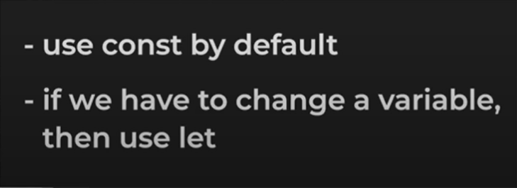
WAYS TO CREATE VARIABLE:
let, const, var
var is not mostly used but to create new JS use let by default.
typeof is used to find the type of the given value.

Slide 9
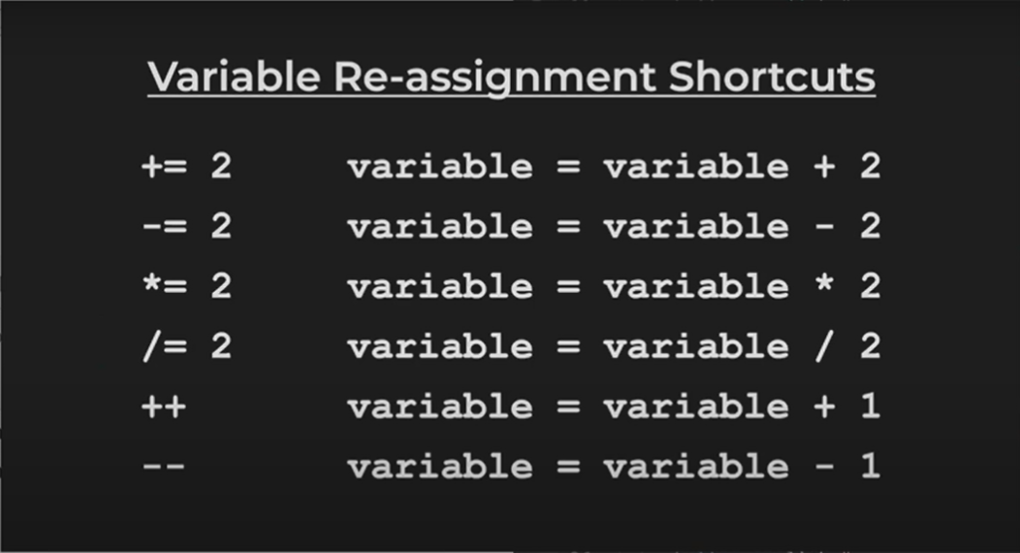

Slide 10
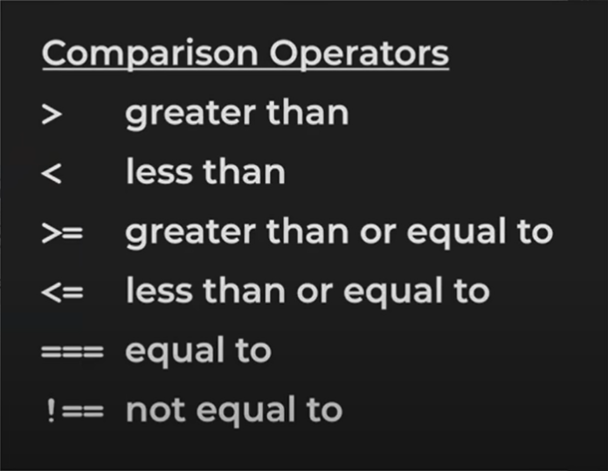
COMPARISON OPERATORS:

Slide 11
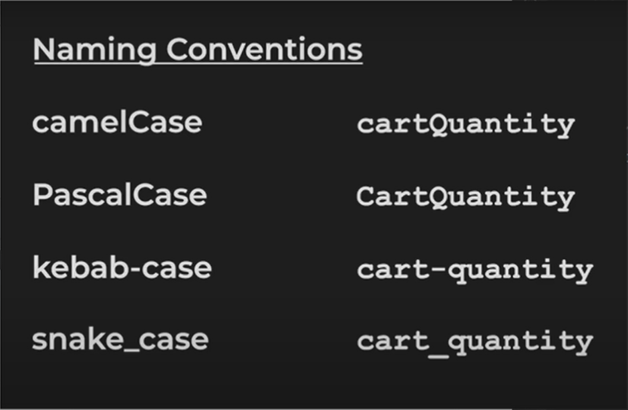

Slide 12
NAMING CONVENTIONS:
Variable name as ‘ cartQuantity ’ where Q is uppercase and remaining in lowercase. This is called camelCase.
kebab-case is used in HTML and CSS and can’t be used in JAVASCRIPT.
snake_case is used in other languages but not in JAVASCRIPT.

Slide 13
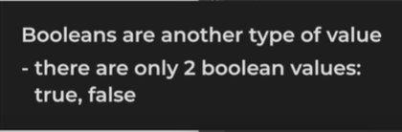

BOOLEANS:

Slide 14
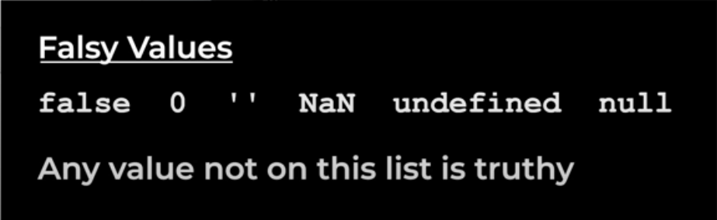
TRUTHY AND FALSY VALUES:

Slide 15
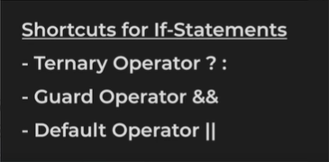

Slide 16
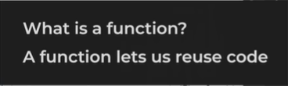
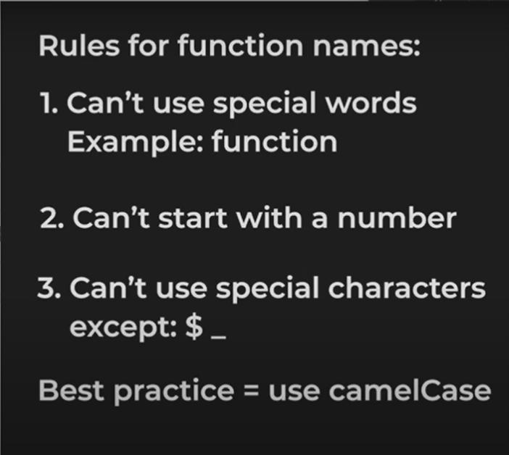
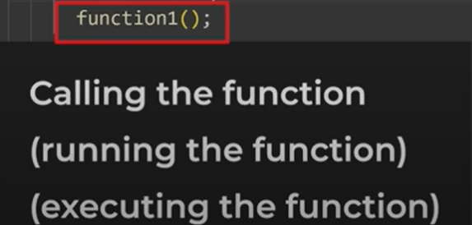
FUNCTIONS:

Slide 17
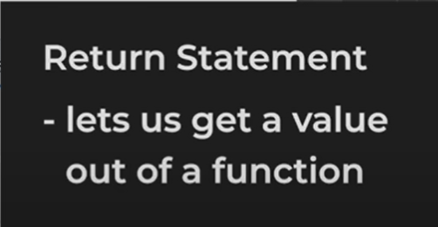
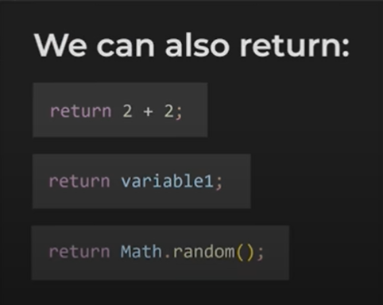
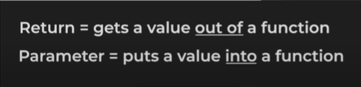
RETURN STATEMENT:

Slide 18
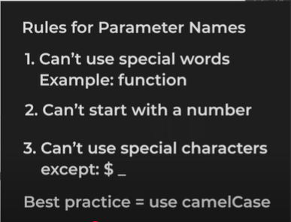
PARAMETERS:

Slide 19
OBJECTS:
An object groups multiple values together. It makes our code more organized.
Eg:
const person = { name: "John Doe", age: 30, occupation: "Engineer", hobbies: ["reading", "hiking", "coding"], address: { street: "123 Main St", city: "Anytown", zipCode: "12345" }
To create an object start with open curly bracket and end with close curly bracket.
Using dot is to access values stored in specific property. Another way is using console.log(variable[‘property’])
Eg: console.log(person . name)

Slide 20
MORE ABOUT OBJECTS:
Inside the object we can put multiple values. For each value the code on the is called property.
You can also change the values in property.
Eg: person.name = ‘ Jhon Doe James ’;
Separate property and value with colon and this is called property-value pair. We can have many property value pair and separate them with comma.
To add new property in existing code use ( variable.newproperty = ‘value’ ; )
To delete use ( delete variable.newproperty; )
We can also save function inside the object.

Slide 21
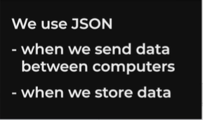
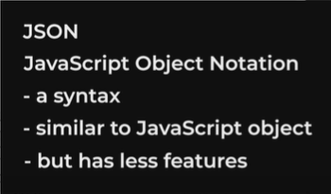
BUILT-IN OBJECTS:
The console and math object are known as built-in objects.
There are two types of built-in objects:
1. JSON (It doesn’t support functions and single quote. It is more universal)
2. LocalStorage

Slide 22
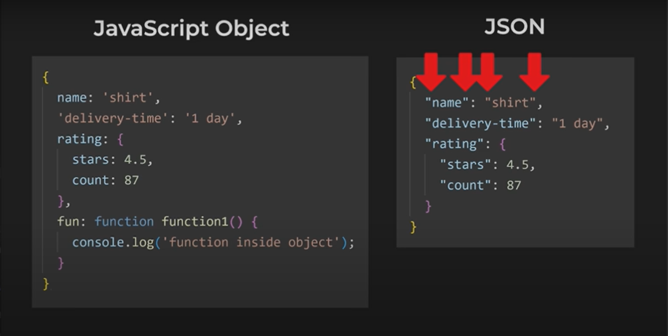
BUILT-IN JSON OBJECT:
Difference between JavaScript Object and JASON is that al properties and strings must use double quotes in JSON. It used to convert JS object to JSON object.
To convert from JSON to JS use “JSON.parse(variable)”

Slide 23

BUILT-IN LOCAL STORAGE:
It is used to save values permanently; it doesn’t get deleted when we refresh or close the page.
Variables are temporary if we refresh or close the page all variables are deleted.
To store the values inside LocalStorage is to use syntax:

Slide 24
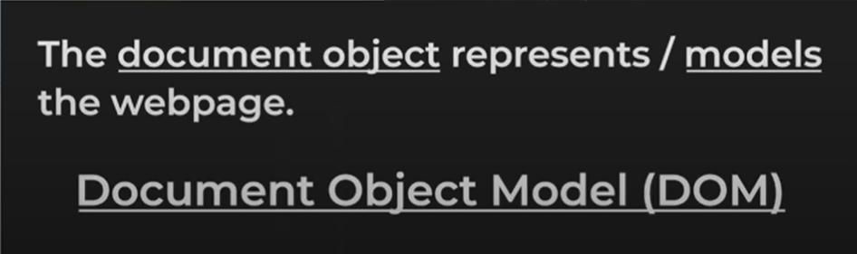

DOCUMENT OBJECT MODEL (DOM):

Slide 25
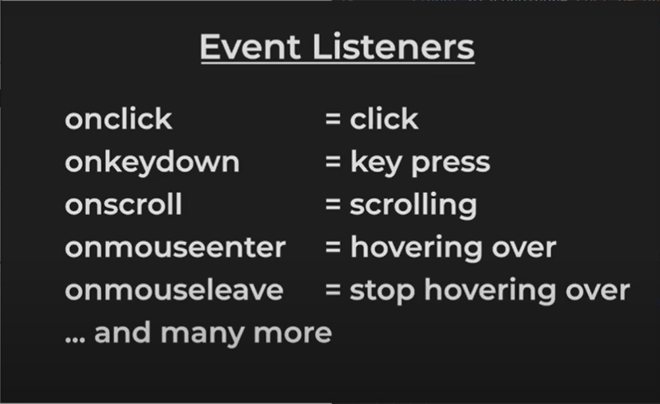

Slide 26

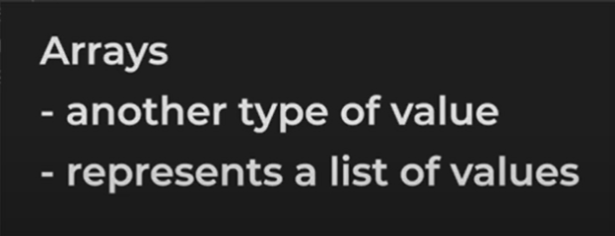
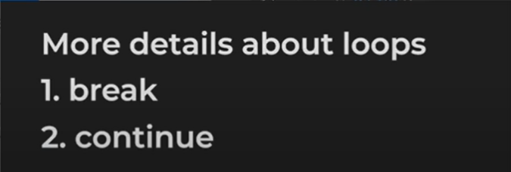
ARRAYS AND LOOPS:

Slide 27
SYNTAX RULES FOR ARRAY:
Start with open square bracket and close square bracket.
Inside we can put list of values and sperate each with commas.
To get a value inside an array we can use square brackets and specify position inside the brackets and this number is called index it’s represents position in the array. Index value starts with 0.
Inside an array we can put any type of value. (for strings use ‘’ and for object use {}.
We can save arrays in variables or in an array.
To add array in an array use square backets inside it.
An array is a special type of object.
Array.length is a property used to find number of values in an array.
.push is a method to add a value at the end of the array.
To remove a value in array .splice method is used.

